Slide 1

Greater Minneapolis Crisis Nursery
Community
Impact
Presentation
Notes:
Introduce yourself
Your involvement with the Crisis Nursery
“Thank you for having me”

Slide 2
Greater Minneapolis Crisis Nursery
Established in 1983, the mission of the Greater Minneapolis Crisis Nursery is to end child abuse and neglect and create strong, healthy families.
Notes:
Our mission is to end child abuse and neglect and create strong healthy families.

Slide 3


Notes:
We are a voluntary short term shelter for kids 6 years and under.
VOLUNTARY – parents choose to bring their children there – which we look at as a strength
At the Nursery, asking for help is a strength. You can imagine how hard that must be especially asking a stranger for help with your little ones..
Their parent bring them to the Crisis Nursery for up to 72 hours, while they take care of whatever their crisis may be.
They define their own crisis and it can be anything from getting out of a dangerous or domestic situation to just needing a break.
No one wakes up in the morning and thinks, “I want to hurt my child” – it’s because they are at the end of their rope and out of tools.
So we take a two generation approach and keep the child safe and at the same time give the parent the resources and tools they need to get through their crisis.

Slide 4
What we do:
  24-hour crisis line
  Home visiting
  Mental Health Services
  Residential crisis nursery
Notes:
We work toward our mission in a few ways besides the actual shelter.
We have a 24-hour crisis line for parents to call for resources, community referrals, and crisis counseling for help through difficult situations.
We offer a Home visiting and mental health program
For families that have multiple barriers to self sufficiency (homeless, jobless, single parenting, kids with disabilities, experiencing mental illness)
Master level practitioners go into the home, shelter, where ever the family is living and work 1:1 with these families.
They work to knock away goal after goal – for 12-18 months or so.
Hopefully in the end they are more self sufficient and more informed about successful parenting practices.
And then we have the actual Residential nursery
We serve 20 kids a day
Ages 6 years and under (that is the highest risk for abuse)
They can stay for up to 72 hours at a time
For a total of 30 days in a year (usually 48 hours in between stays)

Slide 5
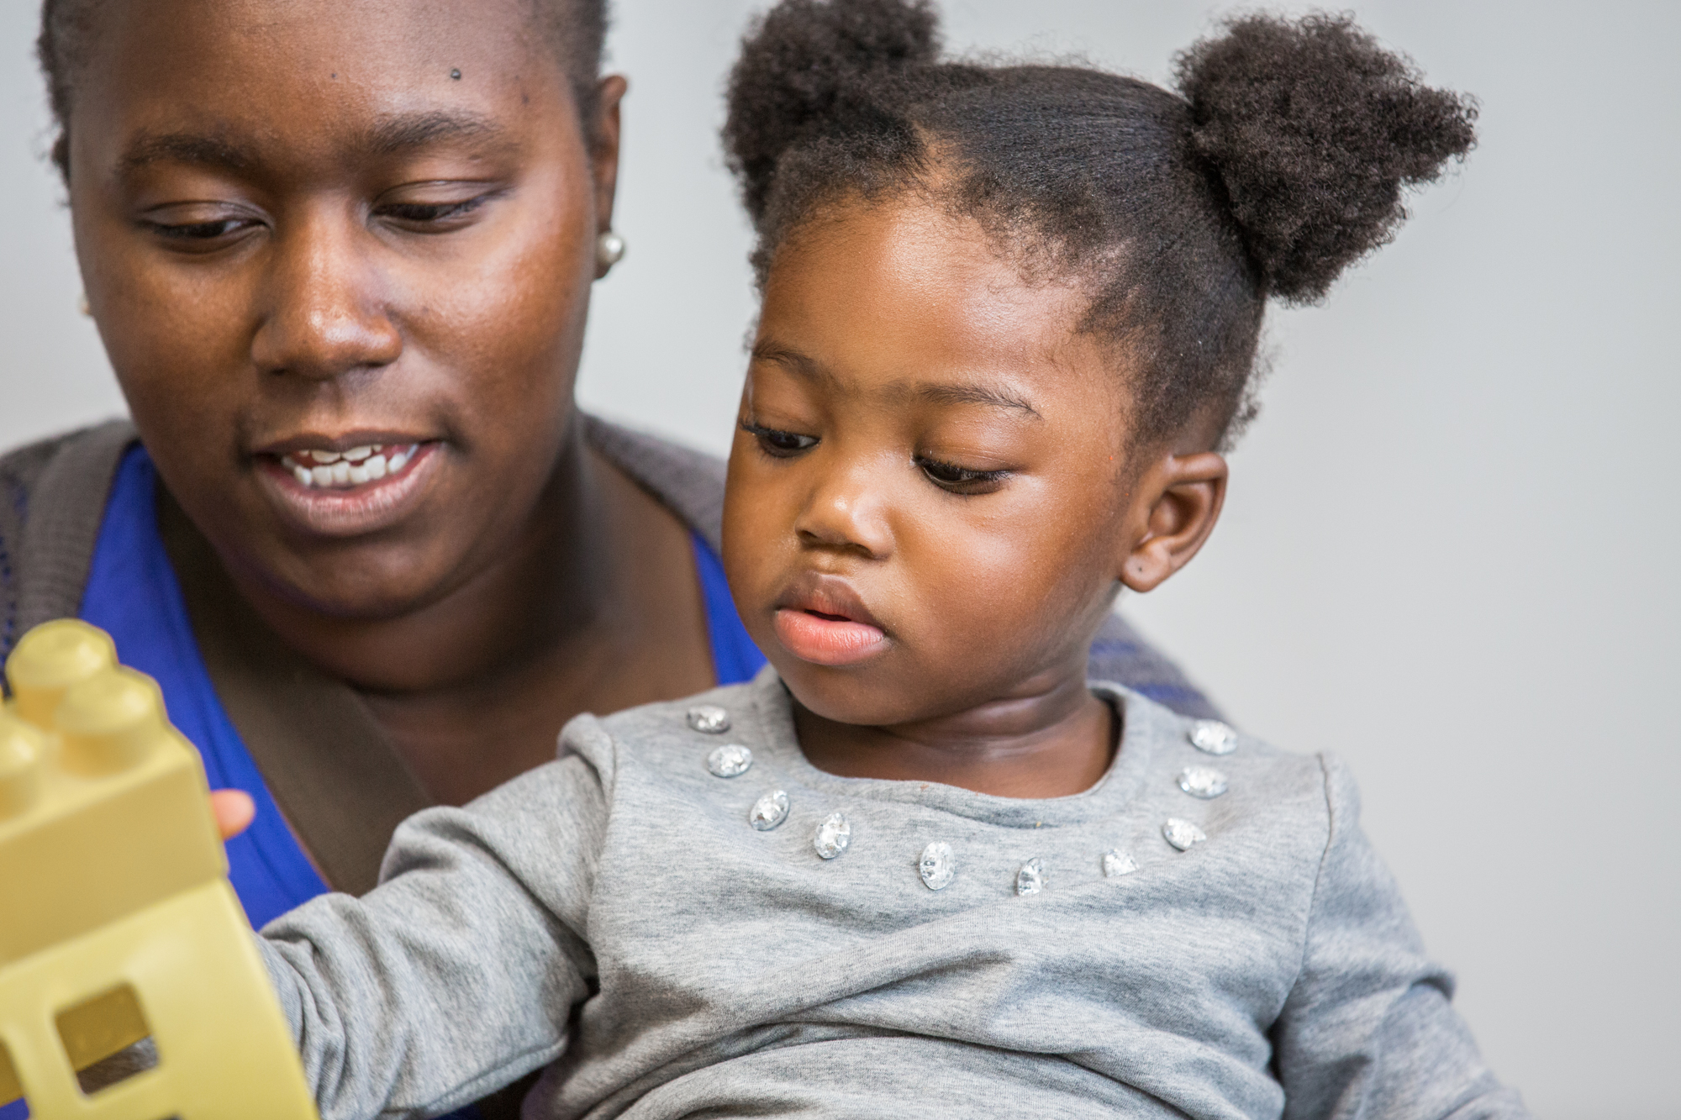
Notes:
Two generation approach – we give both the parent and the child tools to deal with their daily stressors.

Slide 6
Who we serve:
Hennepin County Residents
Over 80% annual income < $10,000
Over 90% are single parenting moms
Over 40% insecure housing (self disclosure)
25% domestic violence (self disclosure)
Notes:
Although our families are all unique, the majority have a few things in common:
The one requirement is they need to be a resident of Hennepin County
Over 80% annual income < $10,000
Over 90% are single parenting moms
Over 40% have disclosed they have insecure housing (this is self disclosure so that number is more than likely higher)
25% have disclosed they experienced domestic violence (this is self disclosure so that number is more than likely higher- it’s not an easy thing to share with a stranger)

Slide 7
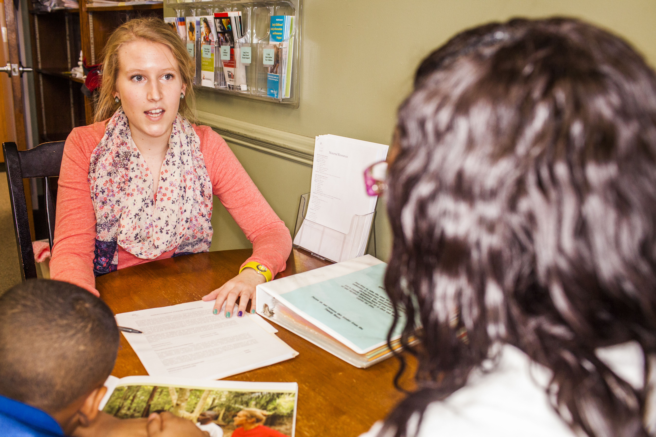
Notes:
We encourage our families to utilize our services as much as possible, because the more we can work with them, the deeper the level we can help.
They don’t tell us everything the first time, but the more we see them, the more they disclose- once we develop trust.

Slide 8
A day in the life:
  Crisis Call
  Intake
  Daily Schedule
  We provide everything
    Transportation, clothing, diapers, food, formula
Notes:
What a Nursery stay looks like–
After the Crisis Call the parent schedules an intake-
INTAKE
First we talk about the child (allergies, asthma) – everything we need to know to take care of them to the best of our ability
Then the children are taken up to Children’s Services
We then talk to the parent about what their crisis is and they make goals for themselves as to what they are going to do while their kids are with us
We give them resources and referral to achieve those goals.
Then we talk about basic needs (food, clothing shelter) and see if we can hook them up with resources for those, if needed.
We talk about safety – most of our parent have never felt safe…in their homes, families, or relationships – so we can try to build some framework as to what that might look like for them.
And finally we talk about parenting, what’s working and not working. Whatever is working KUDOS to them (especially under the circumstances we talked about earlier).
Whatever isn’t working we make goals for the kids to work on while they are at the Nursery.
Examples: He won’t go to sleep at night, he’s up until 3am, if I am late to work one more time, I am going to lose my job or she hates brushing her teeth and we can’t afford the dentist right now.
We work with the kids on those goals and in the end let the parent know what worked for us.
We have a consistent schedule daily. We eat 3 meals and 3 snacks, we have activity rooms (art, learning resource, sensory, gym, playground).
We want to help with school readiness for these little ones coming from chaotic environments.
All in all we want to remove barriers to make us easy to use.
We provide:
Transportation
Clothing
Diapers
Food
Formula
We remove barriers – cabs, voluntary
Daily Schedule/Ratio/Volunteers
Nap/Night

Slide 9
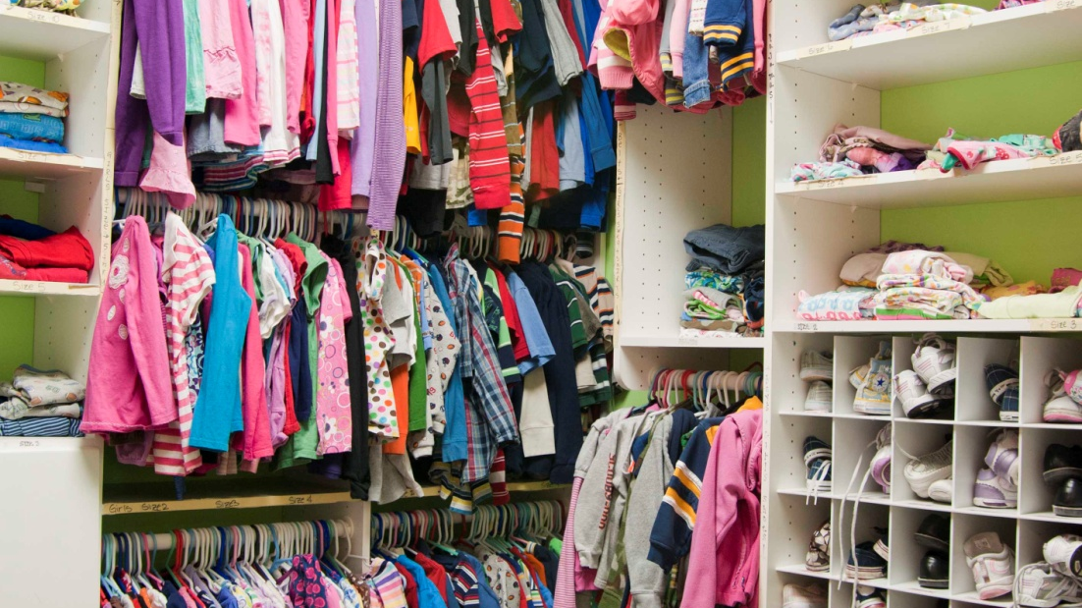
Notes:
We have a clothing closet – where the kids get to pick out their clothes. They wear all of our clothes while they are there.
Another barriers removed – they don’t have to pack and can come straight from a dangerous or domestic situation – we provide it all.

Slide 10
How can you help?
Monetary donations
Host a fundraiser
Invite a speaker
Donate Items from our WISH LIST
VOLUNTEER!
Notes:
Monetary donations - OVER 70% is privately funded, about only 25% from the government and a small % from United Way.
Host a fundraiser – In person like a baby shower, or online – Facebook
Invite a speaker to your personal networks or work networks
Donate Items from our WISH LIST – this wish list is updated monthly
VOLUNTEER!

Slide 11

Notes:
We have over 2500 volunteers that came through our doors last year.

Slide 12
Volunteer Opportunities:
Individual Opportunities
Child Care
Enrichment Activities
Special Events
Skills based Opportunities
Notes:
We have a number of different opportunities:
These are Individual opportunities:
Child care – working directly with the children along side staff, we ask for a minimum of 6 month commitment, twice a month, 3-4 hours shift.
Enrichment – leading an hour’s worth of activities for kids ages 3-6 years old. Staff is in there with you – arts/crafts or sports games (large muscle)
Special events – 2 a year a luncheon in the spring and wine tasting in the fall.
Pro bono – or skilled opps – graphic design, contractor, lawyer, writer, art, program mgmt., etc.

Slide 13
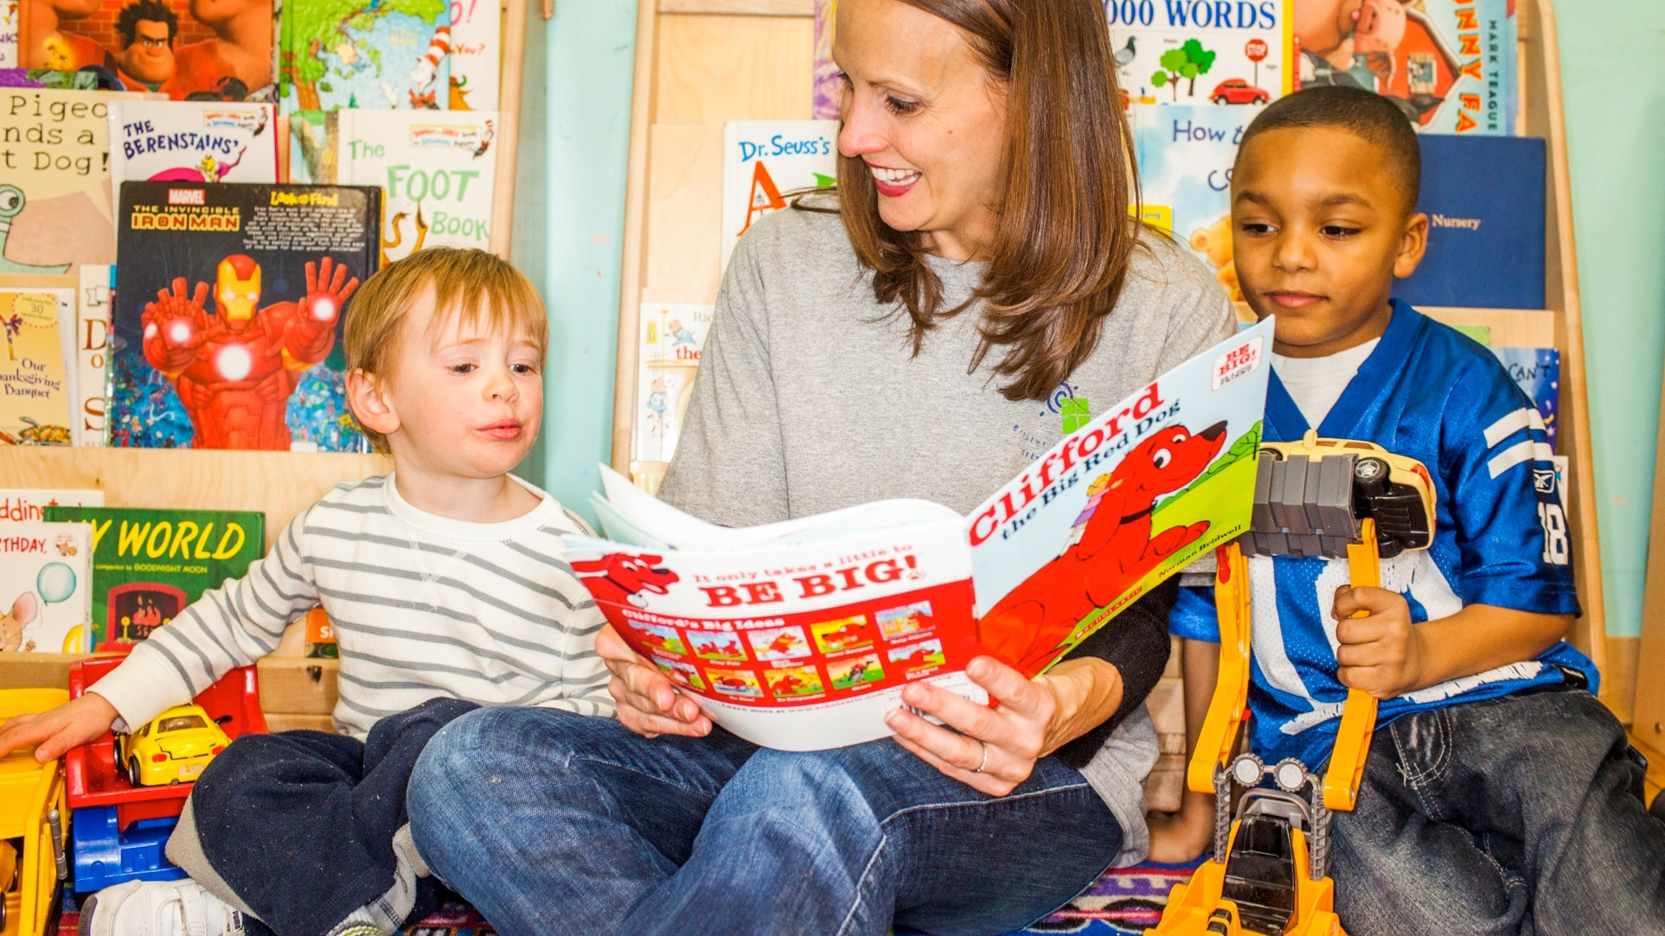

Slide 14
Volunteer Opportunities:
Group Opportunities
Cook for Kids (6 ppl. max.)
Creative Snack for Kids (6 ppl. max.)
Special Events
Large Groups (Yardwork, Facilities)
Notes:
We also have small group opportunities:
CFK and Creative Snack
6 ppl max.
Two choices – shopper or chef
Shopper – you buy food, prepare, serve and sit eat with the kids and clean up.
Chef – you give us $100, we have the recipe and food here (no sopping on your part required) then YOU prepare, serve and sit eat with the kids and clean up
Large Groups – Yardwork, facilities, like painting, deep cleaning, etc.

Slide 15


Slide 16




Learn more at:
www.crisisnursery.org
Notes:
You can find more information on our website –
All applications can be submitted right on the website.

Slide 17


Slide 18

Notes:
Any questions?

Slide 19
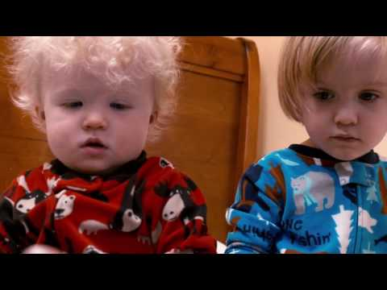
Notes:
https://youtu.be/Zs12rpPpxlk
Video link if you have extra time.

